Slide 1
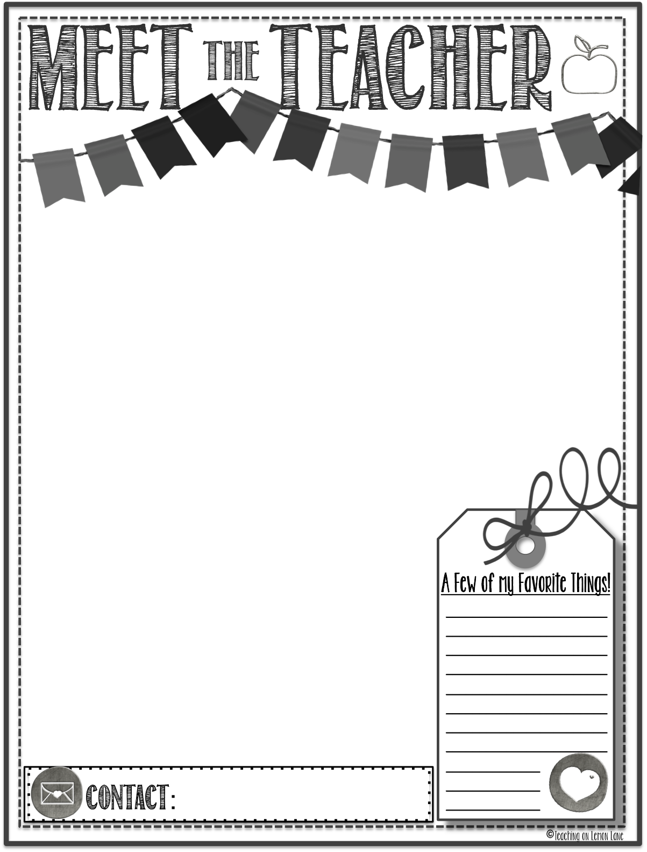

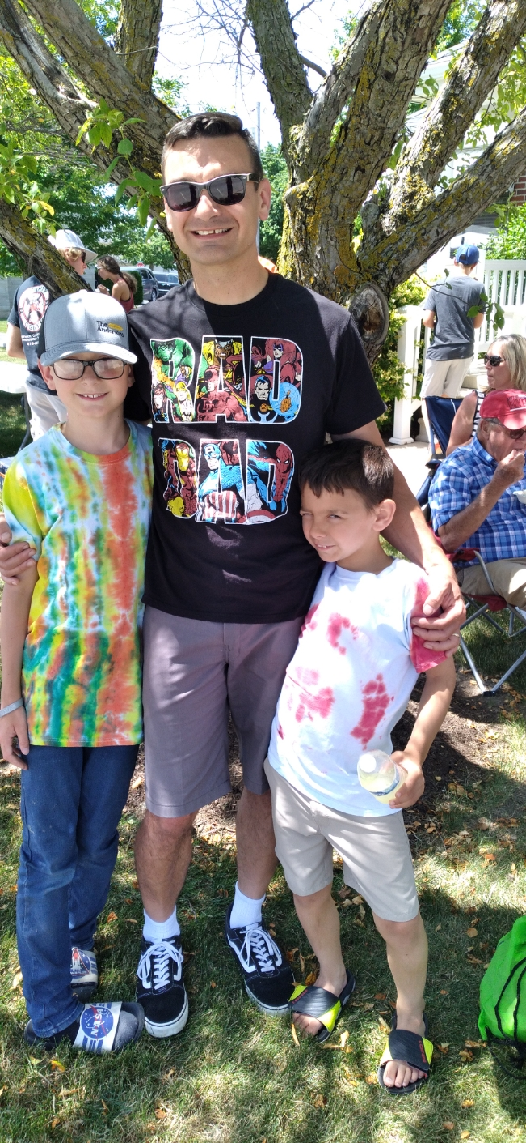
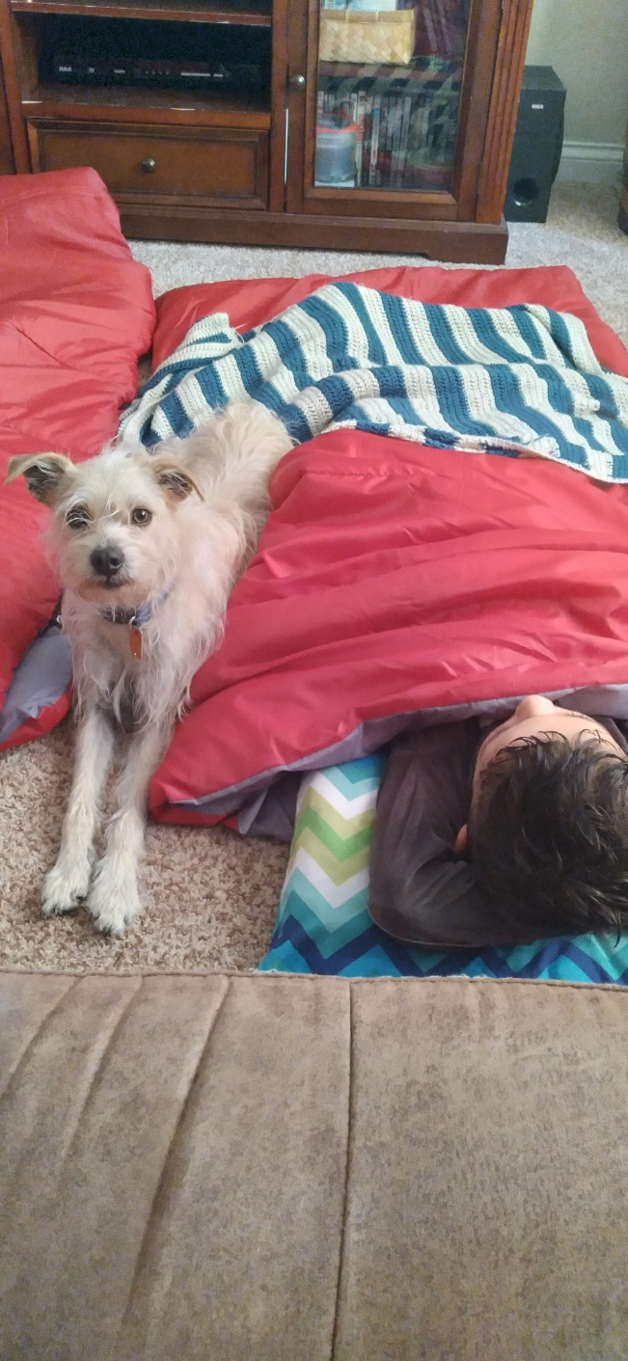
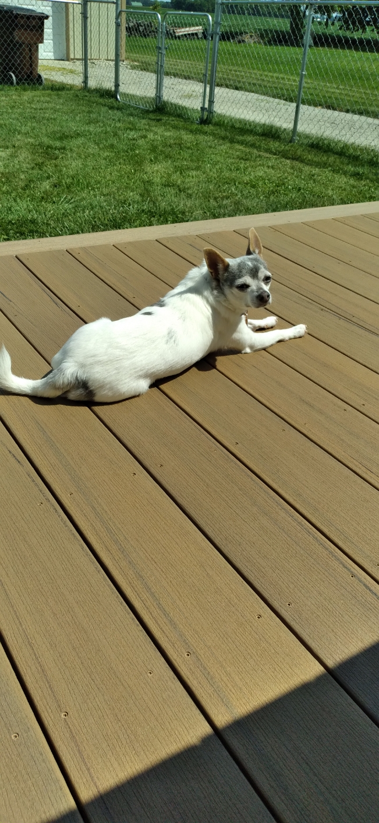
Mrs. Miller
I am excited to be your student’s 3rd grade Language Arts teacher this year! This is my 11th year teaching, and I am ready to make it the best year so far! I am excited to learn and grow with my class. I know that with hard work, kindness, and GRIT, we can accomplish anything!
I grew up in Martinsville, Ohio and graduated from Wilmington High School. I enjoyed reading, dancing, and twirling a flag in marching band.
I graduated from Wilmington College in 2005 with my BA and the University of Dayton in 2007 with my MA. In 2012, I finished courses at IUE to earn my teaching license. I am Reading Recovery trained and have been attending gifted training over the last 4 years.
Today
My husband Joe is from Darke county. We have been married for 12 years and have a 9 year old son named Emmett and a 7 year old son named Abner. We have two dogs—Violet and Comet.
My Family
Game: Uno
Food: Pizza
Treat: Anything Chocolate
Candy: Sour Patch
Drink: Coffee
Color: Purple and Blue
Place to Shop: Online
Sport: Baseball
Subject:
Reading
Hobby: Running
amiller@gcswave.com
937-548-1013

